Slide 1
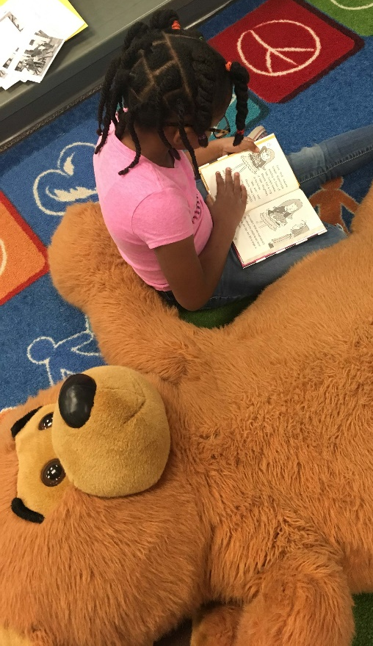


For the Love of Reading
Building the Foundation
Kathleen Decker- Principal
Christine Herbert- Magnet Theme Coordinator
Presenters:

Slide 2

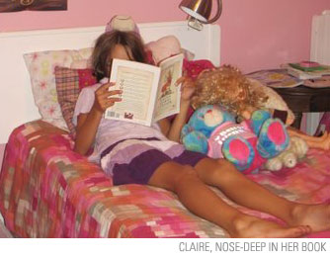
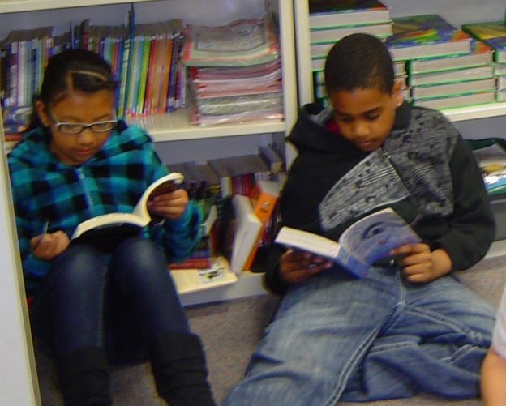
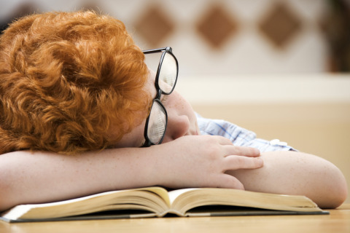
Are your kids seriously reading?
Are they really finishing books?
Do they read on
their own?
Or do they look like this?

Slide 3
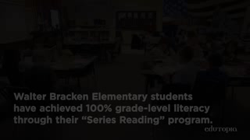
Edutopia Video

Slide 4

The Problem:
Students read a lot of information today in short bursts.
They change channels and multi-task.
To develop good reading comprehension we want them to sustain interest and finish the novels that they start reading.
As soon as they are done we want them to have the desire to read another.
Some classroom teachers are not familiar with current book series choices.
Most teachers have a wide range of levels in their rooms.
ELL students do not have the vocabulary to constantly learn new book terms.
Notes:
Katie

Slide 5

Our Solution
Have all students read complete series of books.
Have individual goals and rewards.
Establish grade level benchmarks for success.
Have all staff members participate for a common mission throughout the school.
Have a lot of choices to meet students interests and levels.
Notes:
Katie

Slide 6

What We Will Cover Today:
Data that shows our growth
Where to start
Tools that we use including AR and MyOn
The website and resources for you to get started
The culture at the school now – things we did to enhance the program
No AR, no worries – alternatives to that program
Parent perspective
Questions
Notes:
Data that shows our growth - Katie
Where to start - Katie
Tools that we use including AR - Chris
The website and resources for you to get started - Chris
The culture at the school now – things we did to enhance the program – Michelle
Parent perspective - Michelle
No AR, no worries – alternatives to that program – Klaus

Slide 7
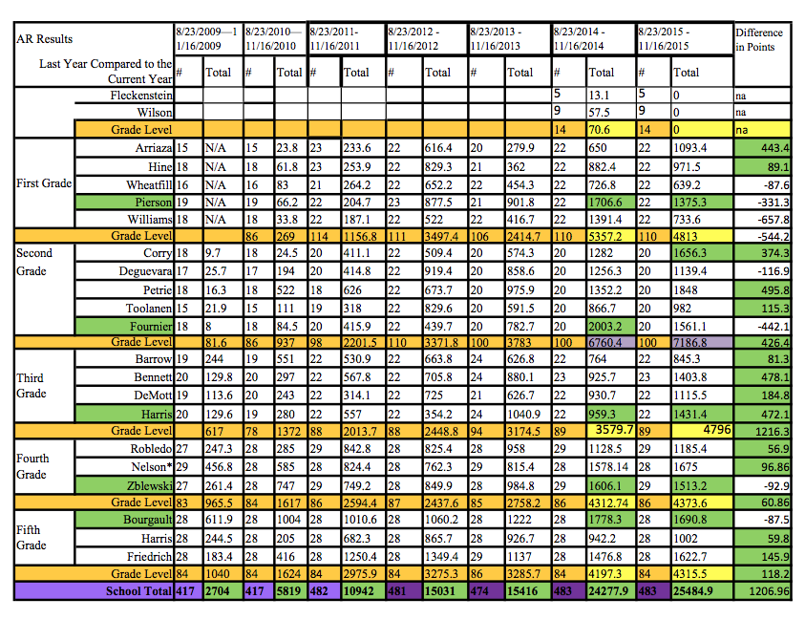
Monitor Data At The Same Point
Notes:
Katie

Slide 8
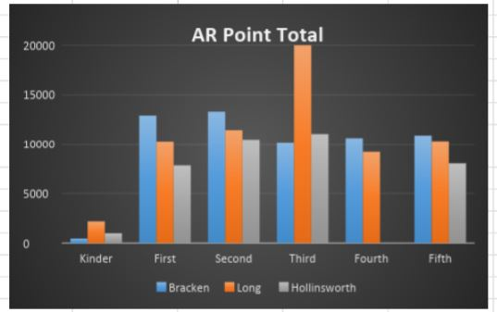
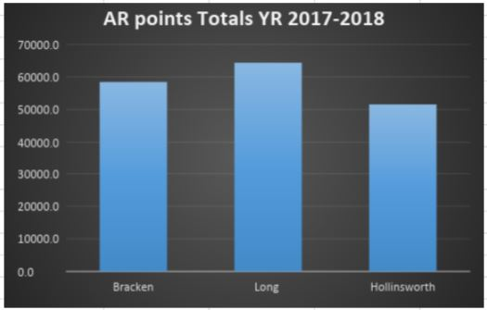
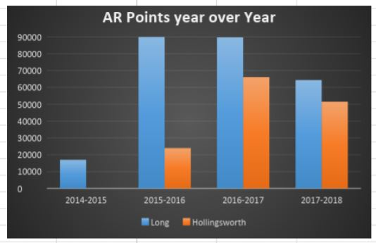
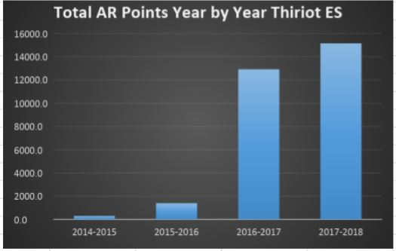
Notes:
Katie

Slide 9
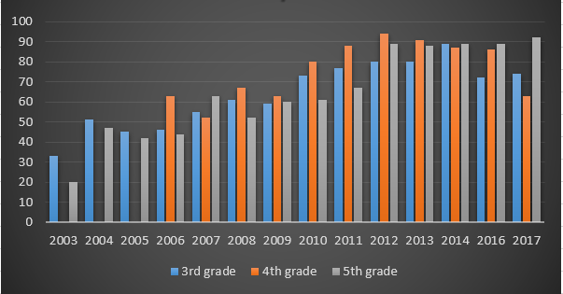
Bracken’s Reading Proficiency Results
No test results for 2015 – change from CRT to SBAC
Notes:
Katie

Slide 10
What We Had To Do First:
Have everyone just start with one series.
Purchase 16 books to get everyone started.
Teach a mini book club class to get them started.
Get everyone involved including parents.
Stick to the series idea – tricky at first but it will pay off!
Be flexible – you are changing bad habits for older kids. The younger grades are the easiest to start!
Notes:
Katie

Slide 11
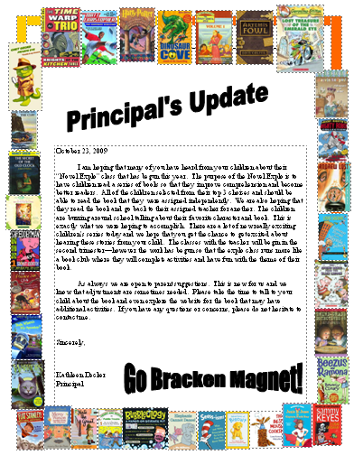
Inform Parents
October 23, 2009
I am hoping that many of you have heard from your children about their “Novel Explo” class that has begun this year. The purpose of the Novel Explo is to have children read a series of books so that they improve comprehension and become better readers. All of the children selected from their top 3 choices and should be able to read the book that they were assigned independently. We are also hoping that they read the book and go back to their assigned teacher for another. The children are buzzing around school talking about their favorite character and book. This is exactly what we were hoping to accomplish. There are a lot of new really exciting children’s series today and we hope that you get the chance to get excited about hearing these stories from your child. The classes with the teacher will begin in the second trimester—however the work has begun so that the explo class runs more like a book club where they will complete activities and have fun with the theme of their book.
As always we are open to parent suggestions. This is new for us and we know that adjustments are sometimes needed. Please take the time to talk to your child about the book and even explore the website for the book that may have additional activities. If you have any questions or concerns, please do not hesitate to contact me.
Sincerely,
Kathleen Decker
Principal
Notes:
Katie

Slide 12
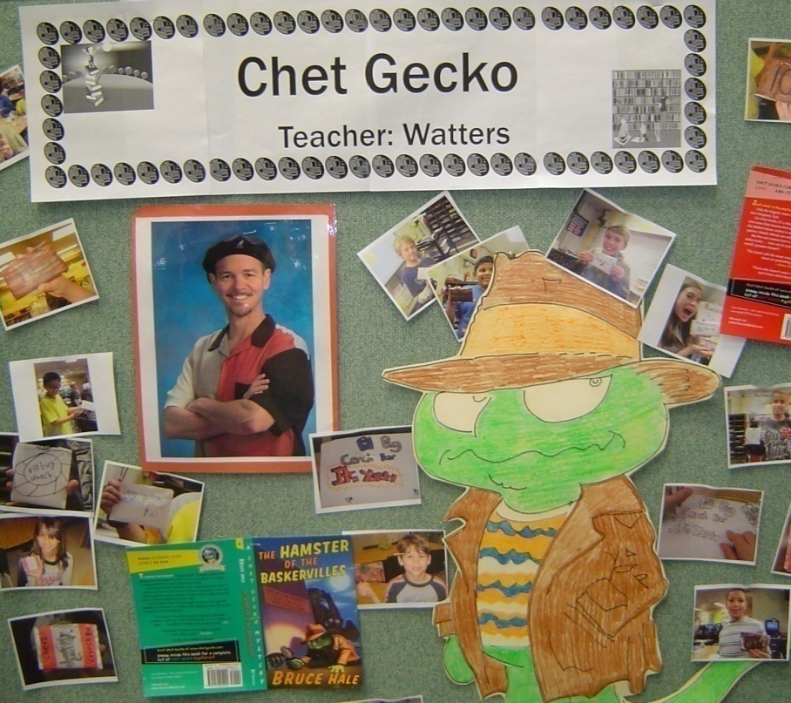
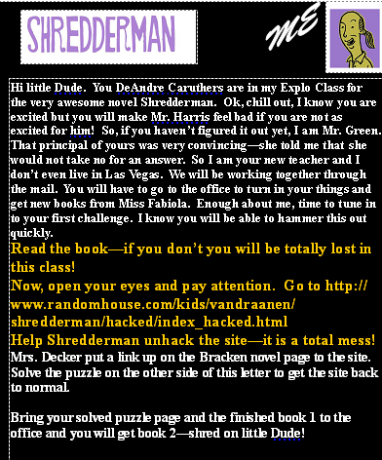
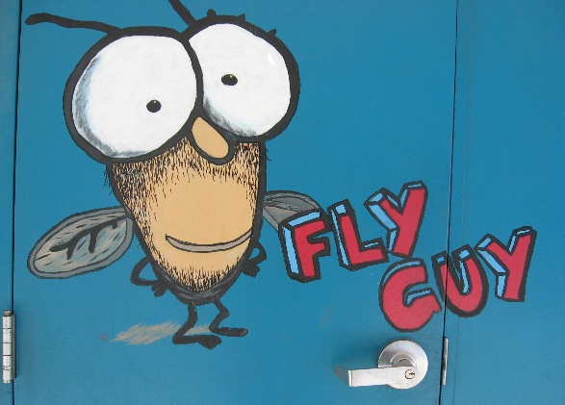
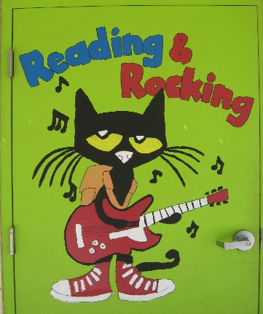
Create Excitement
Notes:
Katie

Slide 13
Now What We Do
Have staff members select the series that they are able to promote.
Have the teachers buy the books and store them in the classroom. Currently we purchase 6 of each title.
Prepare bookmarks for keeping track of the series.
Prepare face bookmarks for the staff to track who is reading their series.
Prepare the Website for kids to become familiar with the choices.
Notes:
Katie

Slide 14
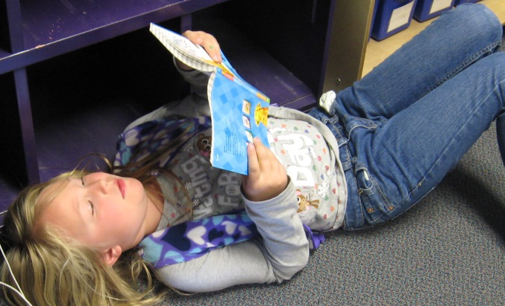
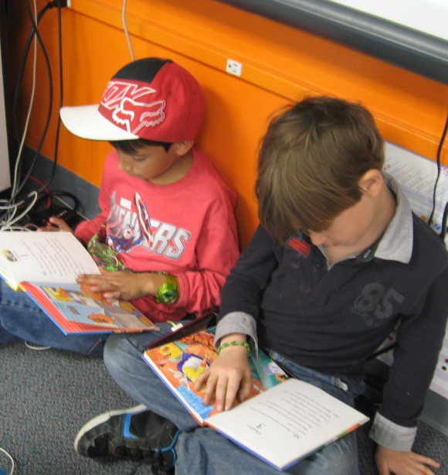
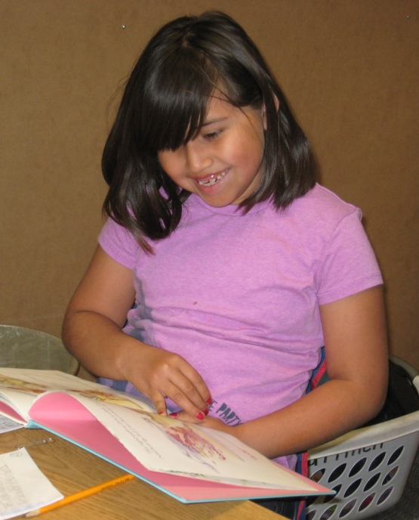
Tools That We Use
Website
MyOn
Face Bookmarks
Series Bookmarks
Rewards
Charms
Lamp of Knowledge Trophy
Classroom Rewards
Notes:
Chris

Slide 15
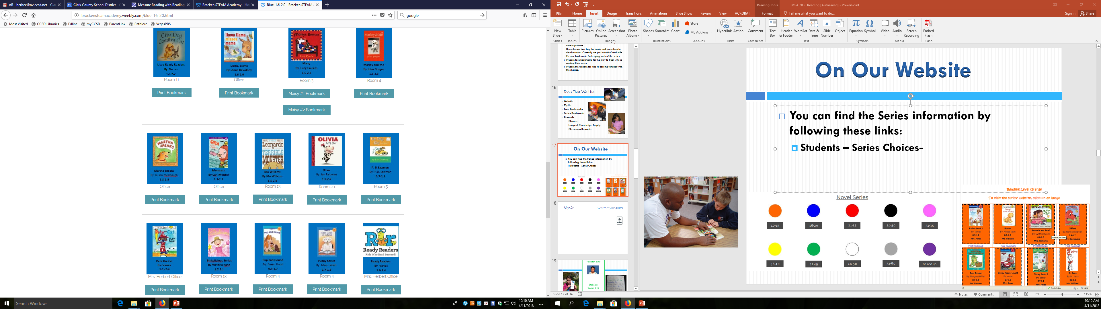
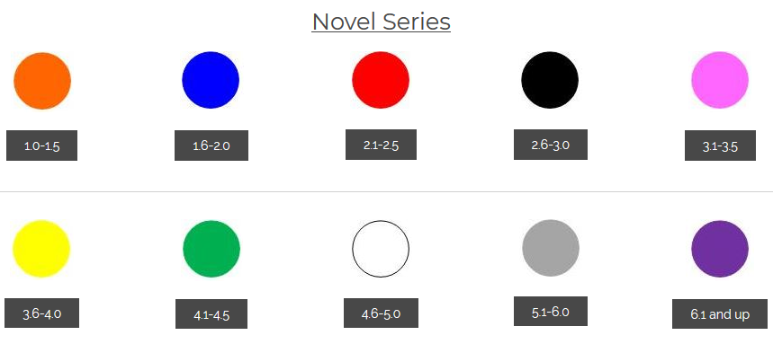
On Our Website
You can find the Series information by following these links:
  Students – Series Choices
  Parents- Reading Series
Notes:
Chris

Slide 16

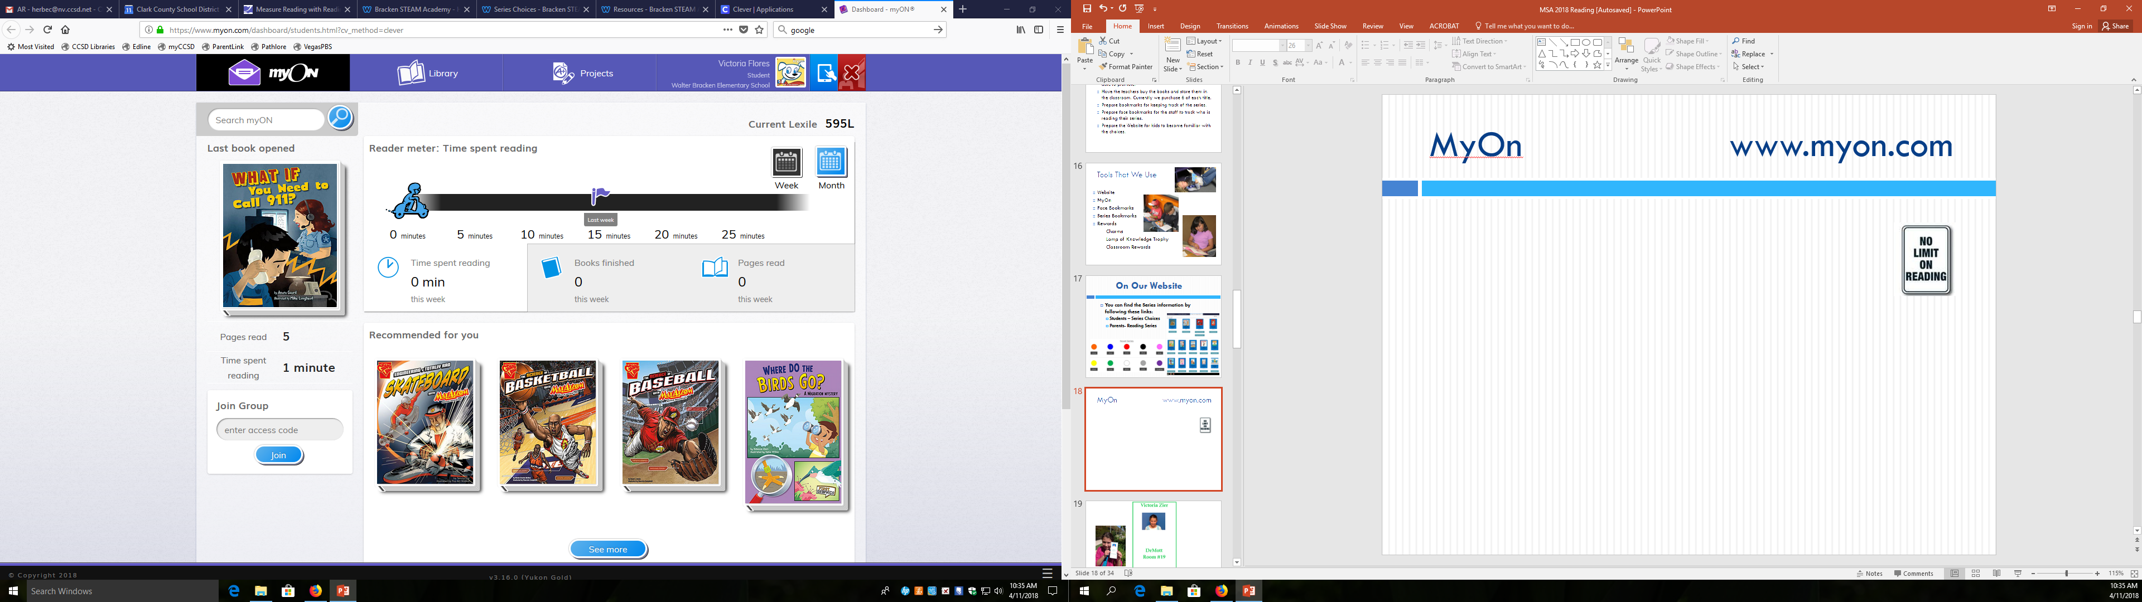









MyOn
www.myon.com
#1(152273)
#2(152275)
#3(152276)
#4(152277)
#5(152270)
#6(152272)

Slide 17

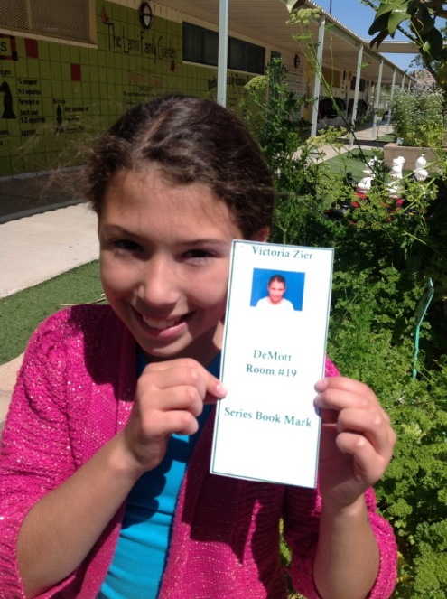
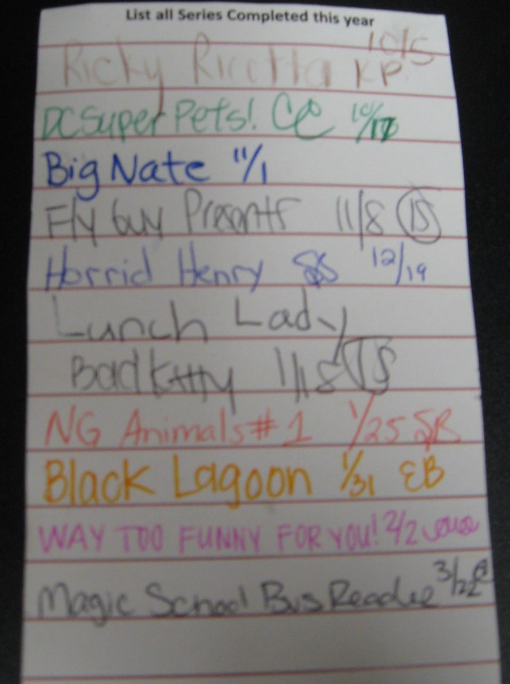
Face
Bookmark
List all Series Completed this year

Slide 18




















Artemis Fowl
#1(54675)
#2(122340)
#2(59973)
#1(139497)
#3(68990)
Series Bookmarks
#5(133847)
#4(87709)
#4(101305)
#6(126340)
#5(109333)
#8(104778)
#7(116920)
#9(110407)
#6(123436)
#11(153908)
#7(139060)
#12(145162)

Slide 19
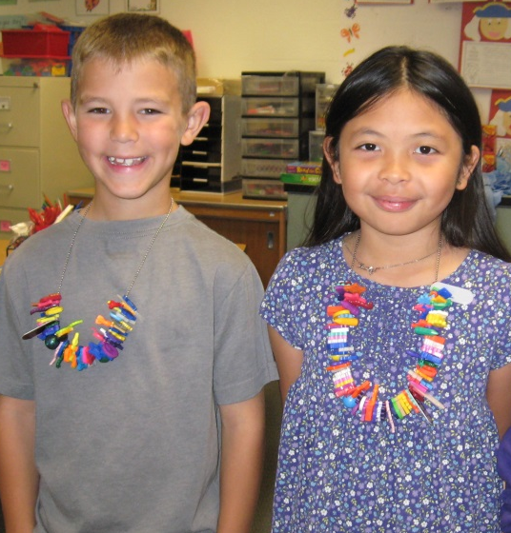
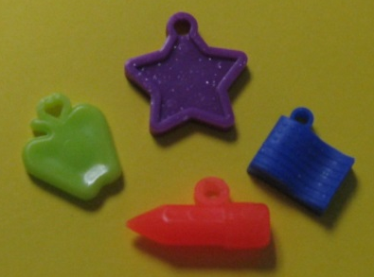
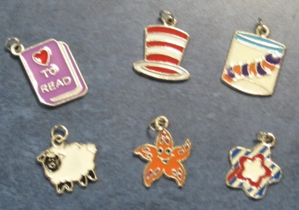
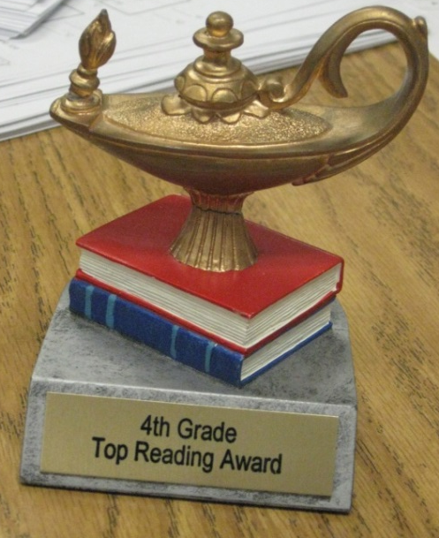
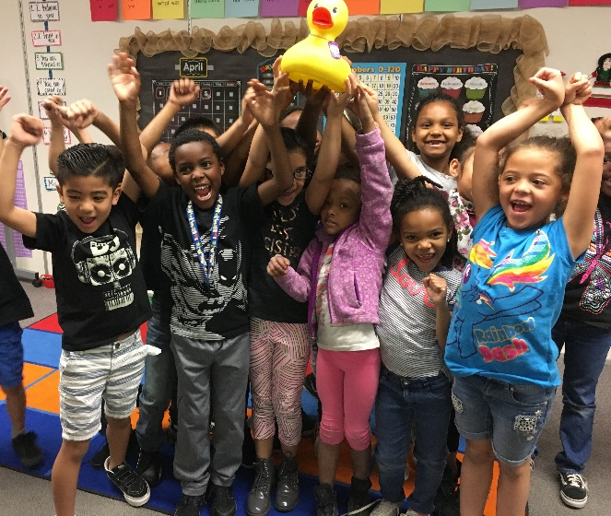
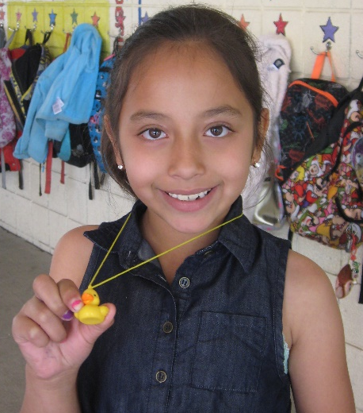
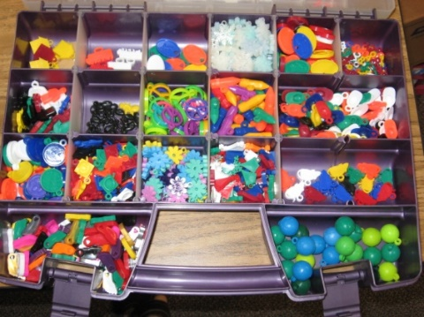
Have A Celebration System
Set Up For Consistency
www.fitnessfinder.net
www.orientaltrading.com
www.carnivalsavers.com
‎
Notes:
Chris

Slide 20
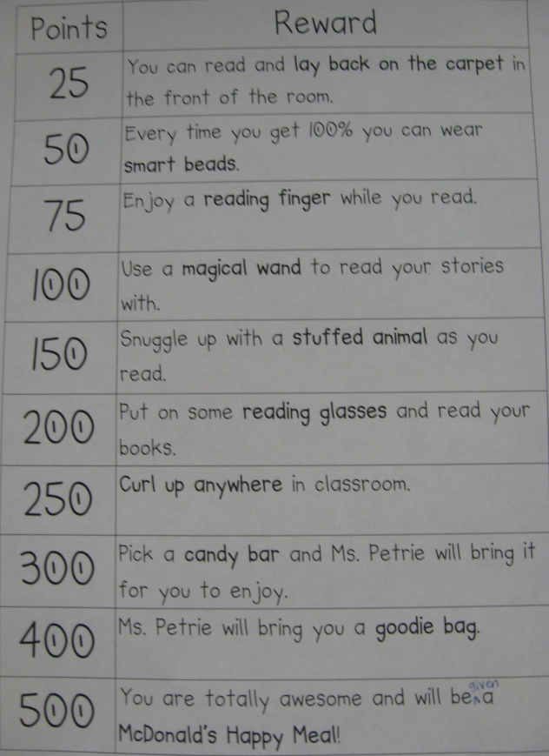
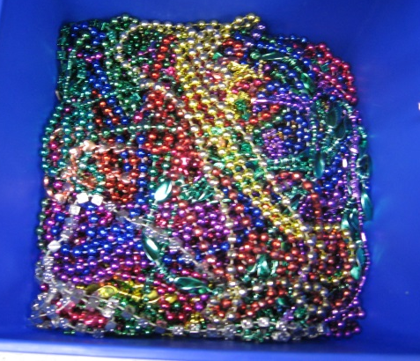
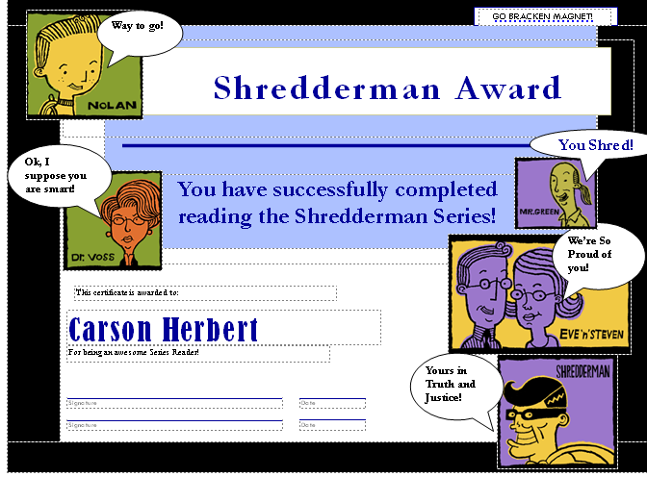
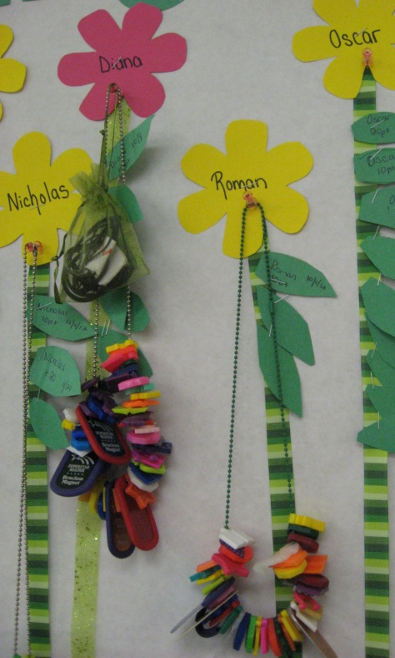
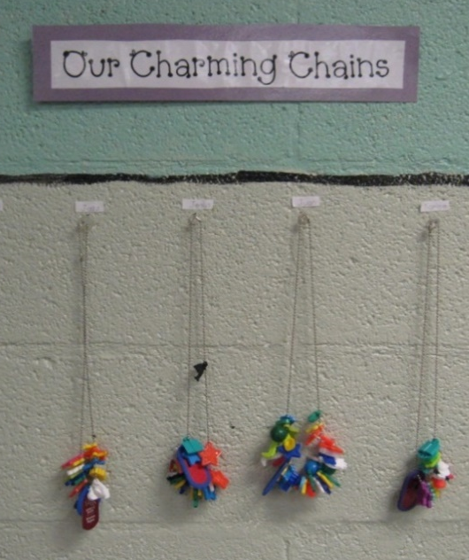
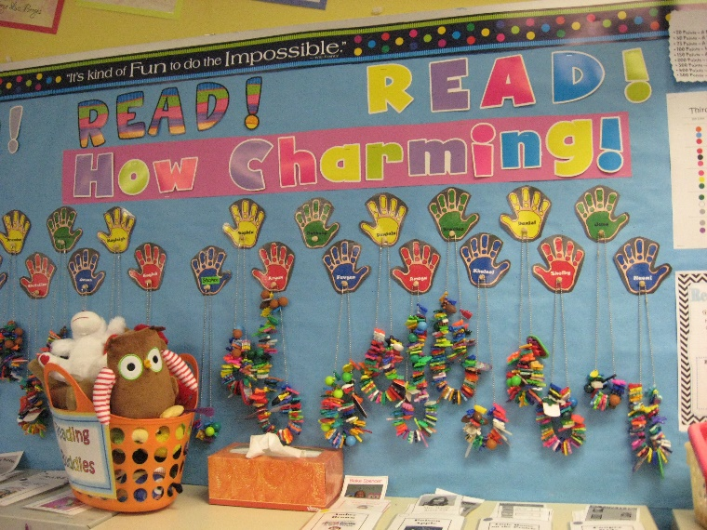
Rewards
Smart Beads
Notes:
Chris

Slide 21
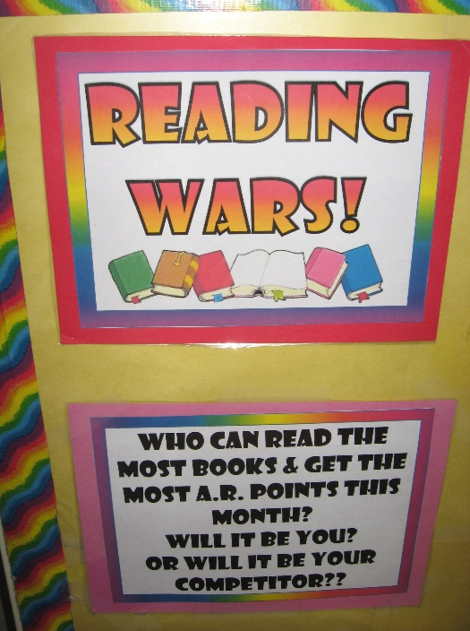
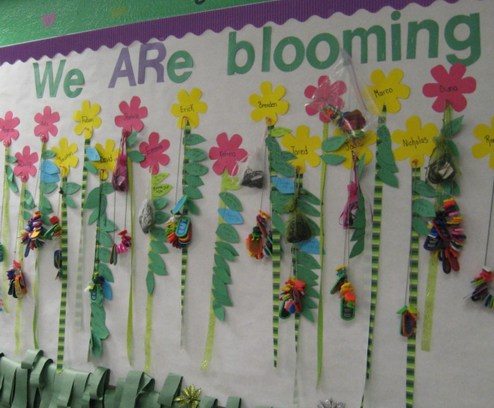
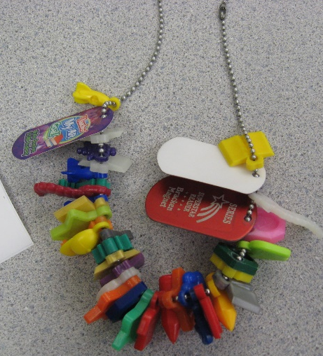
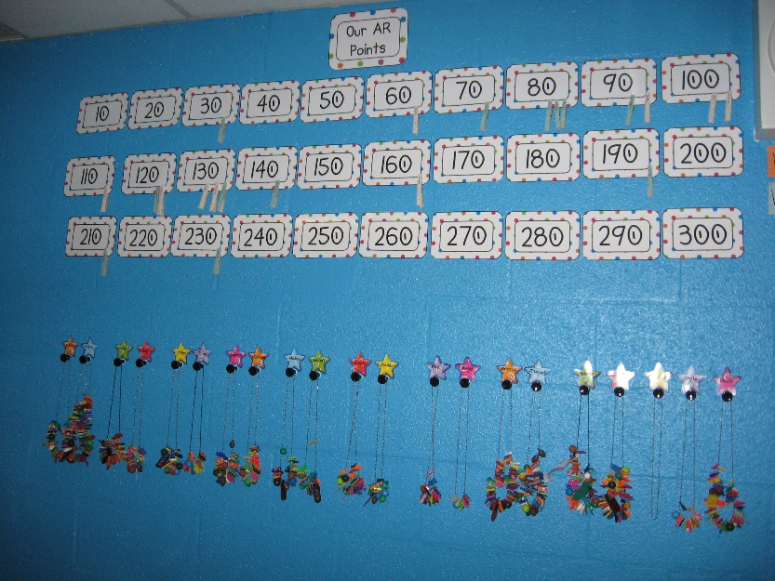
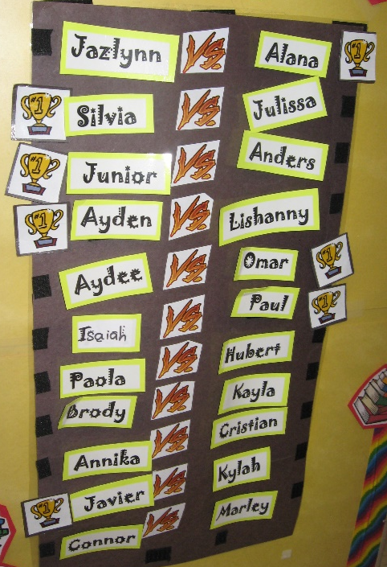
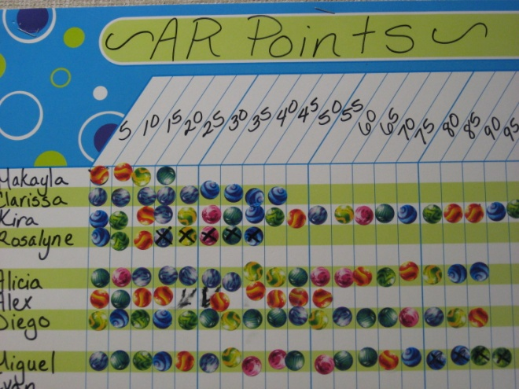
Tracking Student Progress
Notes:
Chris

Slide 22
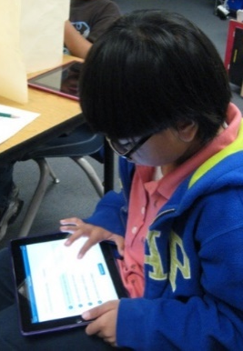
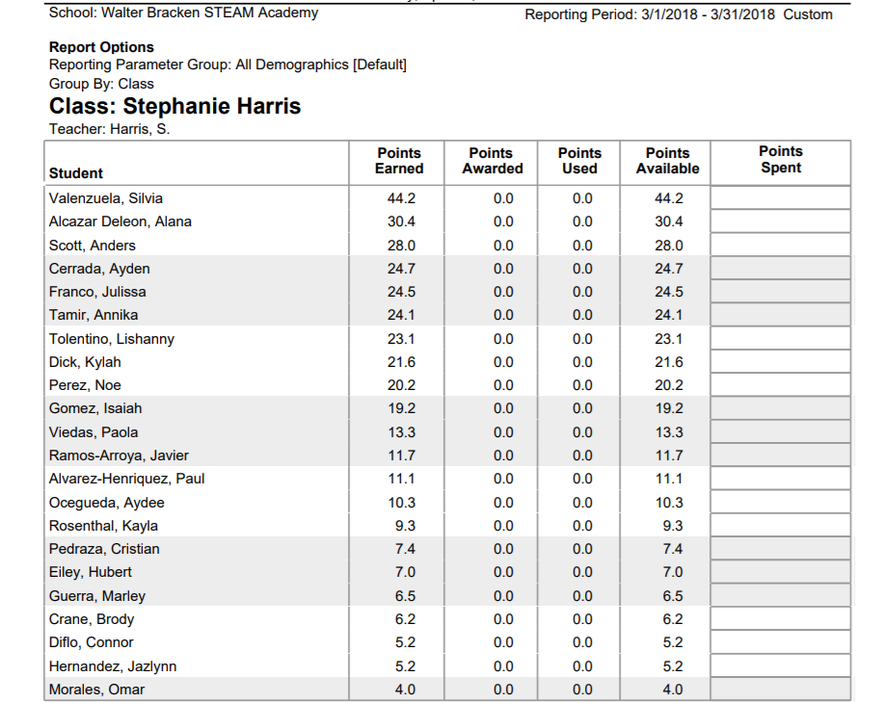
Tracking AR Data

Slide 23
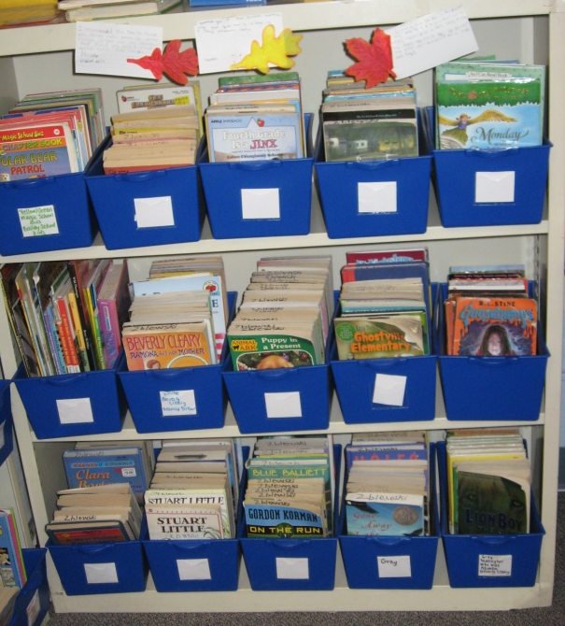
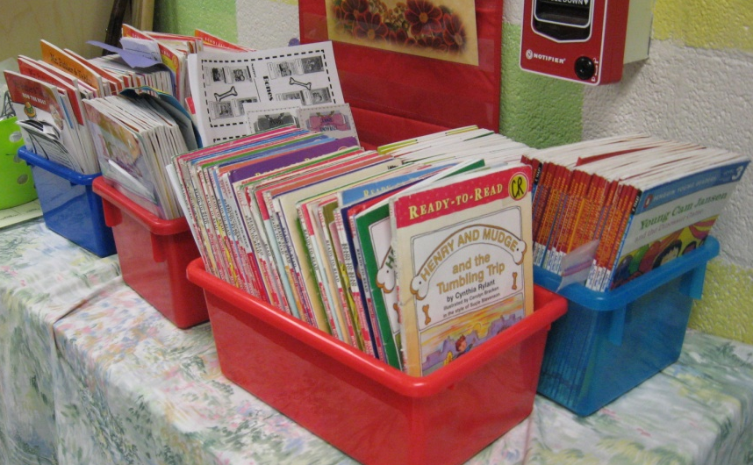
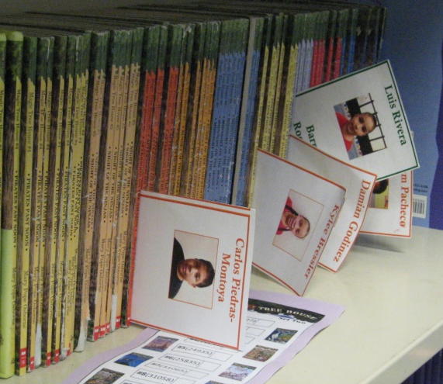
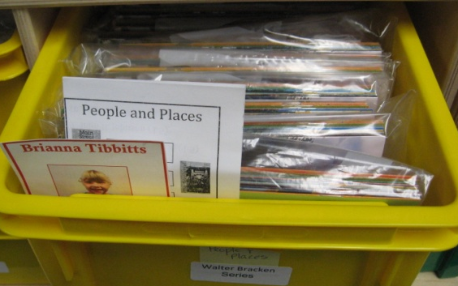
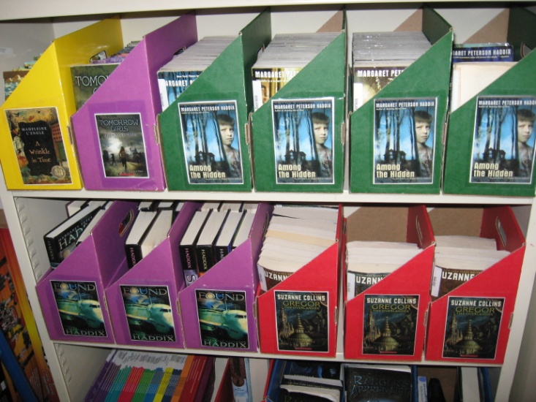


Ways To Organize Books
Notes:
Chris

Slide 24






Ways To Organize Bookmarks

Slide 25



Worried About Losing Books?
Face bookmarks
Label books
Walter Bracken
Series
Books will get damaged and go missing.
-Ask parents to replace the books
-Ask Partners to help
-Use Scholastic Book Club Points
-Scholastic BOGO Book Fair
-Donor’s Choose
-Write Grants
Notes:
Chris

Slide 26


Accelerated Reader Website & Other Resources
Points and levels are already done for you!
  AR Finder
Number of questions range from 5 to 10.
Countless teacher manuals and online lesson plans already have questions done for you.
Notes:
Klaus

Slide 27





Resources
Google Forms
Edulastic
GoFormative
The Answer Pad V2
Socrative
Poll Everywhere
Notes:
Klaus

Slide 28

Non Digital Quizzes
Paper test on your book series.
Create a basket in your room for drop off.
Template for everyone.
Easy grading and number of
questions can be reduced.
Notes:
Klaus

Slide 29



Parent Perspective
Renaissance Home Connect
Benefits
  Staying Informed
  Encouragement
Notes:
Michelle

Slide 30


Get Your Partners Involved

Slide 31







A Culture of Reading
Notes:
Katie - Questions

Slide 32







Color Your World with Books

Slide 33


Sharing The Love of Reading

Slide 34


Sharing The Love of Reading

Slide 35
Schools That Have Added Series Reading
Walter Bracken STEAM Academy- Series Choices
http://brackensteamacademy.weebly.com/series-choices.html
Walter Long STEAM Academy- Series Choices
https://longsteamacademy.weebly.com/series-choices.html
Howard Hollingsworth STEAM Academy- Series Choices
http://hollingsworthsteamacademy.weebly.com/series-choices.html
Thriot Elementary School - Series Craft:
https://www.thiriotes.com/series-craft
Mountain View Elementary School- Accelerated Series: http://www.mountainviewes.org/accelerated_reader/accelerated_reader.jsp
Pinecrest Academy-HorizonCampus- Series Reading Program:
http://www.pinecresthorizon.org/apps/pages/index.jsp?uREC_ID=346548&type=d
Pinecrest Academy-Inspirade Campus- Series Reading Program:
http://www.pinecrestinspirada.org/apps/pages/index.jsp?uREC_ID=345369&type=d
Will Beckley Elementary School- Book Club:
https://www.beckleyes.org/apps/pages/index.jsp?uREC_ID=699671&type=d&pREC_ID=1133082

Slide 36

Contact Information
  Walter Bracken STEAM Academy
  1200 N. 27th Street
  Las Vegas, NV. 89101
  702-799-7095
  http://brackensteamacademy.weebly.com/
  Katie Decker - Principal
  Chris Herbert - Magnet Theme Coordinator

